Slide 1
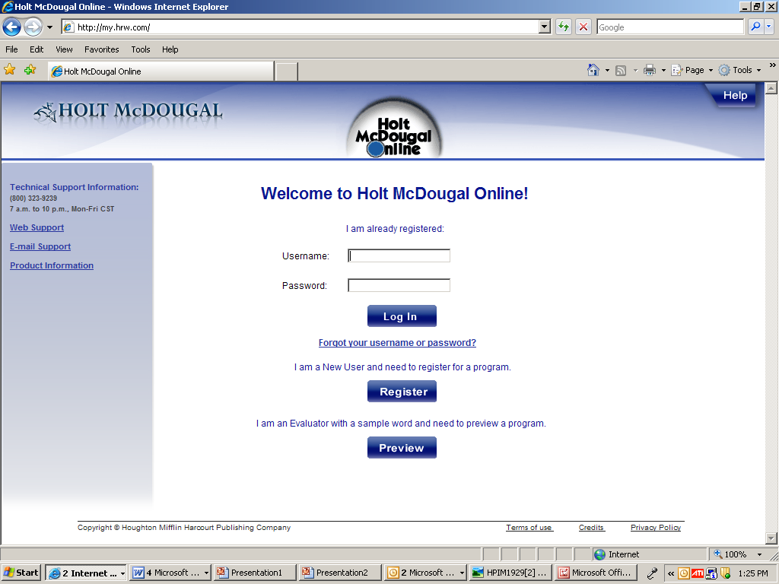
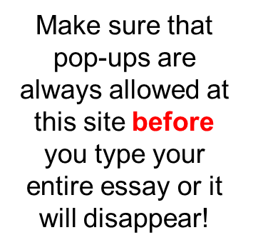
USER: your assigned user name
PW: falcons

Slide 2
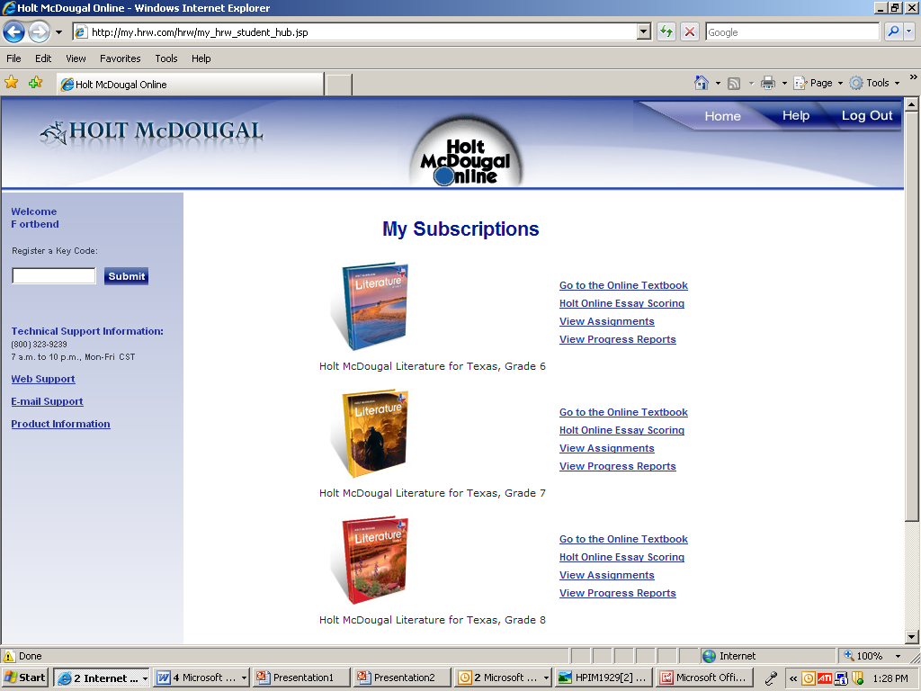
Click Holt Online Essay Scoring

Slide 3
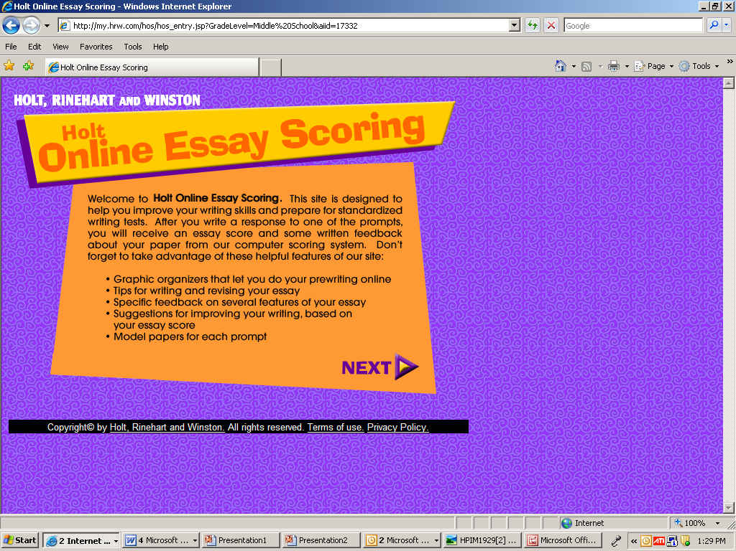
Click Next

Slide 4
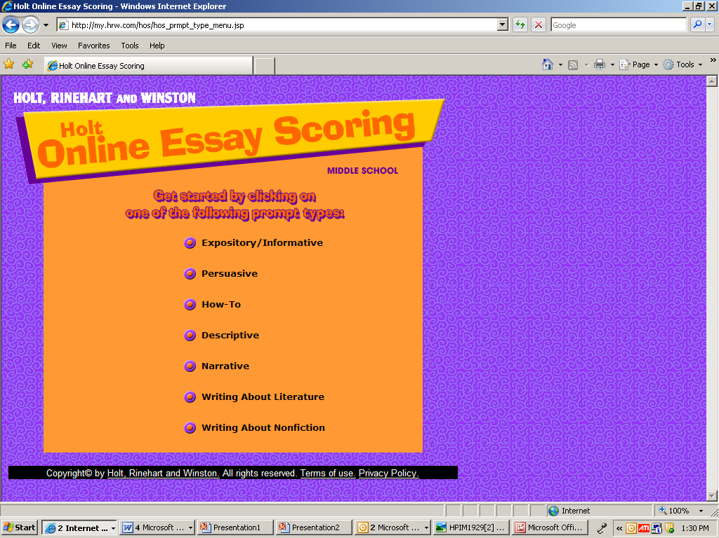
Pick Persuasive
Then pick the prompt of your choice.
When you are READY TO SUBMIT FINAL COPY, go to next slide.
Narrative Prompts

Slide 5
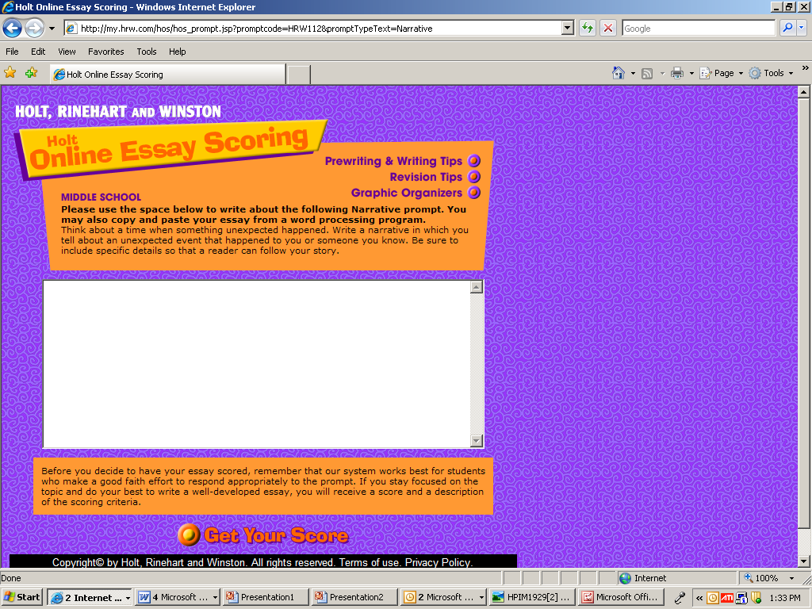
Essay goes here
Make sure you copy and paste from a word document, or the website will log out by itself.

Slide 6
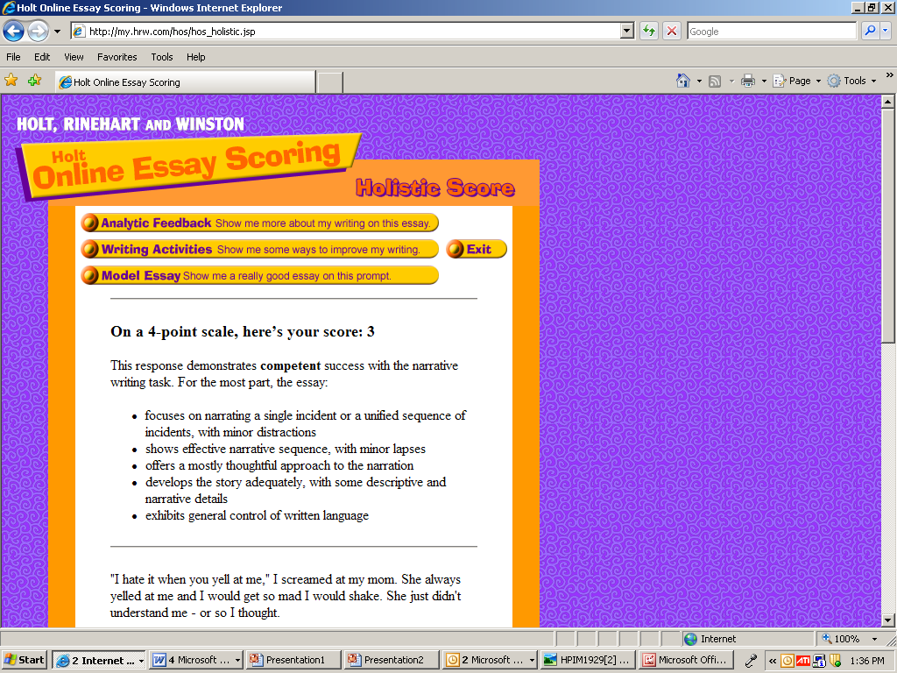
Once your essay is scored, use some of the features available to help you improve your essay BEFORE turning it in. Your teacher’s score may not be EXACTLY the same, but will be close. Are you writing at a “4”??
Print this page to turn in with your final draft.

Slide 7
These power point directions will be available for you to access at home. You may download and print AT HOME from our classroom website.

